Slide 1
Honeywell Powder Amplifier
ME476C
Team 29
Savana Bezdicek, Nicole Mitich, Luke Plumb, Isaac Romero, Jacob Setzer
Notes:
Introductions

Slide 2
Project Description
Terfenol-D is a solid metal material developed by the US Navy for its magnetostrictive properties.
Ex: A 3-in x 0.25-in diameter rod can produce 1000 lbs of output force with an output stroke of 0.003-in
Continue research in Terfenol-D actuation for future use in aviation
Isaac Romero
9/28/16
Team 29: Honeywell Powder Amplifier

Slide 3
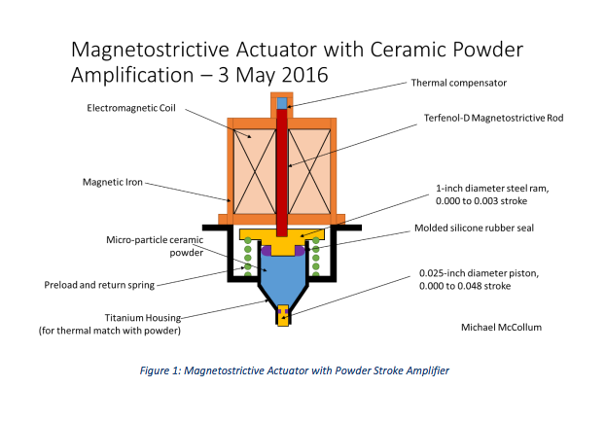
Project Description
Develop a practical “fluid” output amplifier
Study various powders and materials from which the surrounding structure of an output amplifier may be fashioned
The coefficients of expansion for both the amplifier body and powder must be equal
Need: no differential expansion when both powder and the surrounding materials are heated to identical temperatures ranging from -65 to 250 degrees Fahrenheit
Isaac Romero
9/28/16
Team 29: Honeywell Powder Amplifier

Slide 4
Background and Benchmarking
Actuator: converts an unusable source of energy into mechanical energy
Factors: speed, force, acceleration, energy efficiency, etc.
Amplifier: increases the output of the actuator
Current Industry uses:
Aircraft systems
Sound generators (sonars)
Proportional valves
High force generators
Low voltage actuators
Savana Bezdicek
9/28/16
Team 29: Honeywell Powder Amplifier
Notes:
Unusable sources: electricity, hydraulic fluid pressure, pneumatic
Pneumatic: pressurized air
Industry: sound generators: electricity to vibrations for mechanical, acoustic, thermal power
proportionality valves: regulate actuator to adjust the input to output ratio, increases efficiency of a system
High force:
http://www.cedrat-technologies.com/fileadmin/user_upload/cedrat_groupe/Technologies/Actuators/Magnetic%20actuators%20%26%20motors/fiche_AMA/Magnetostrictive_Actuators.pdf

Slide 5
Background and Benchmarking
Last years Honeywell Capstone team:
Proved that the material Terfenol D could be used to produce a practical actuator for driving pneumatic devices such as torque motors
Used a hydraulic intensifier as a hydraulic stroke amplifier
Was able to amplify an output stroke of 0.003 in. to more than 0.030 in. using differential piston areas
The brake fluid the past team used, however, was not suitable for the temperature ranges that occur in airplanes
Luke
Luke Plumb
9/28/16
Team 29: Honeywell Powder Amplifier
Notes:
Topic 2: Background & Benchmarking • Describe several existing designs and/or devices used in similar applications (these will exist for every project, although some will be less relevant than others) or describe the results from different benchmarking analyses completed. Comments:

Slide 6
Customer Requirements and Weightings
Upon selecting a powder and surrounding material, the team will build a proof-of-concept actuator and demonstrate the following:
That the powder has fine enough particles that it will act like a semi-fluid when the large piston in the amplifier is depressed.
That the demonstrator has a method of sealing the large and small such that powder does not leak out of the stroke amplifier over time.
That the demonstrator has an output amplification of at least 10:1.
That the demonstrator will retract to its original position when the force on the large piston is removed.
The team will measure the stroke hysteresis of the demonstrator and provide a curve with the input stroke on the X-axis and the output stroke on the Y-axis. The curve will show both strokes taken in a single open/close cycle with no reversal of input other than that which changes the open command to a close command in order to provide a smooth hysteresis curve.
Luke Plumb
9/28/16
Team 29: Honeywell Powder Amplifier
Notes:
List the design requirements you received from your sponsor.
List the Customer Requirements you generated from the design requirements. (The CRs must completely describe what the project must accomplish; your team should have met with the sponsor mentor to generate these.)

Slide 7
Customer Requirements and Weightings
Jacob Setzer
9/28/16
Team 29: Honeywell Powder Amplifier
Notes:
Decision matrix based off ranking each design idea against general criteria, while leaving out the economical benefits of each design. Ranked ideas for overall feasibility.

Slide 8
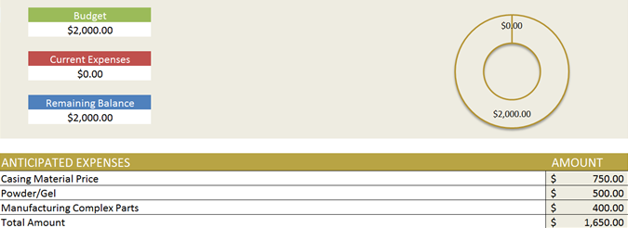
Schedule and Budget
Jacob Setzer
9/28/16
Team 29: Honeywell Powder Amplifier
Notes:
Decision matrix based off ranking each design idea against general criteria, while leaving out the economical benefits of each design. Ranked ideas for overall feasibility.

Slide 9
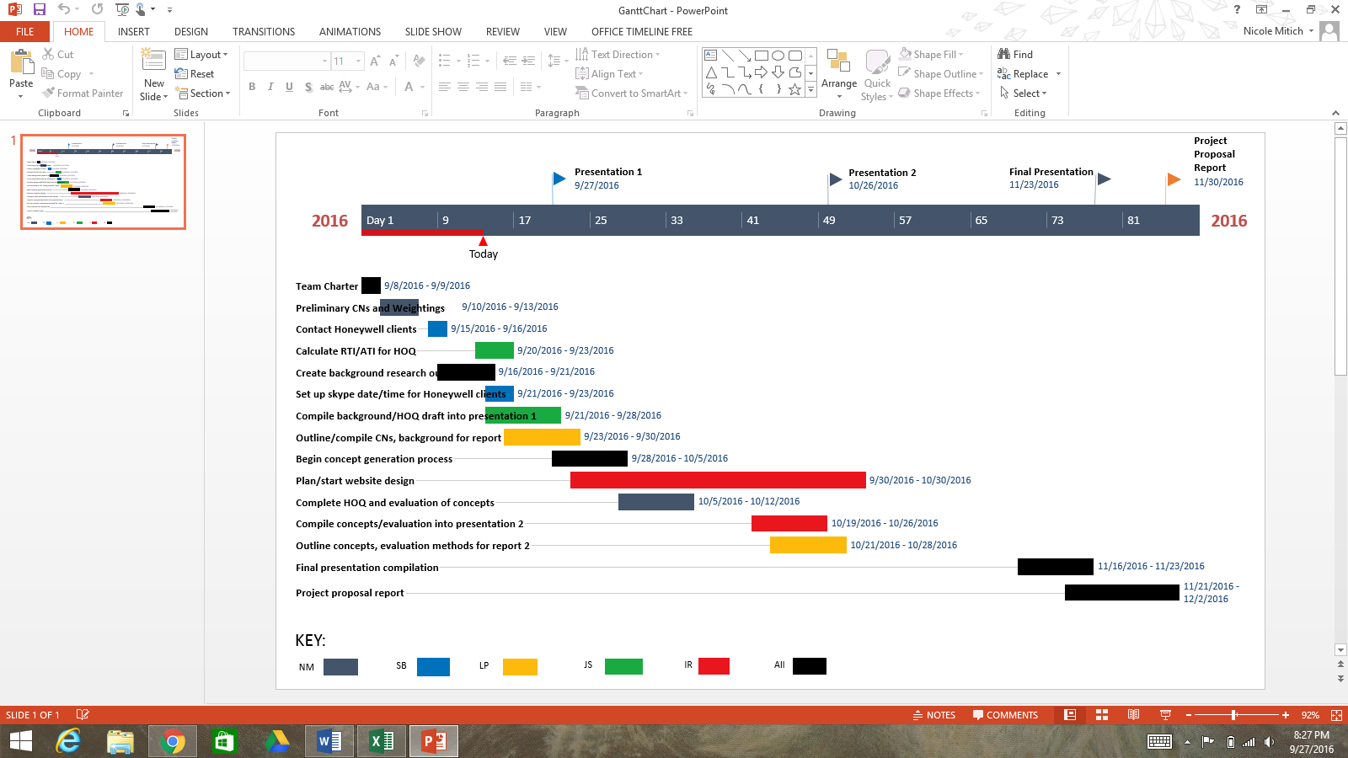
Schedule and Budget
Currently on-schedule for completion
Nicole Mitich
9/28/16
Team 29: Honeywell Powder Amplifier
Notes:
Decision matrix based off ranking each design idea against general criteria, while leaving out the economical benefits of each design. Ranked ideas for overall feasibility.

Slide 10
Work Cited
http://esatjournals.net/ijret/2014v03/i08/IJRET20140308028.pdf
http://www.cedrat-technologies.com/en/technologies/actuators/sonic-ultrasonic-generators.html
"Honeywell." Honeywell. N.p., n.d. Web. 28 Sept. 2016

